Slide 1
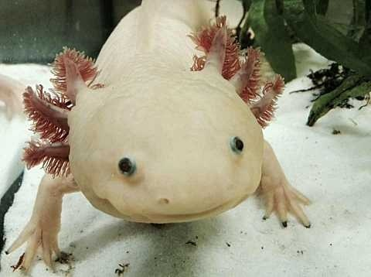
FIND AXOLOTL!
SCAVENGER HUNT
Image source: Wikimedia Commons 2020
Look around the children’s section to find four photos of axolotls. Each one has a fun fact to fill in! Bring your answers to a librarian for a prize.

Slide 2
AXOLOTL FACT #1
Image source: Wikimedia Commons 2020
The Mexican walking fish, as the axolotl is commonly known, is not actually a fish—it is an amphibian! Axolotls can be found in freshwater lakes and ponds in Mexico.

Slide 3
AXOLOTL FACT #2
Image source: Wikimedia Commons 2020
The axolotl is classified as a critically endangered species. In fact, it is almost extinct due to invasive species being introduced into its habitat, as well as habitat loss.

Slide 4
AXOLOTL FACT #3
Image source: Wikimedia Commons 2020
An axolotl can regrow the same limb up to five times!

Slide 5
AXOLOTL FACT #4
Image source: Wikimedia Commons 2020
The feathery branches that extend from either side of an axolotl’s head are its gills.

Slide 6
FIND AXOLOTL!
Look around the children’s section to find four photos of axolotls. Each one has a fun fact to fill in! Bring your answers to a librarian for a prize.
Image source: Wikimedia Commons 2020
The ________________________________ , as the axolotl is commonly known, is not actually a fish—it is an amphibian! Axolotls can be found in freshwater lakes and ponds in Mexico.
The axolotl is classified as a _____________________________ species. In fact, it is almost extinct due to invasive species being introduced into its habitat, as well as habitat loss.
An axolotl can regrow the same limb up to _________ times.
The feathery branches that extend from either side of an axolotl’s head are its __________________.

Slide 7
ANSWER KEY: FIND AXOLOTL
The Mexican walking fish, as the axolotl is commonly known, is not actually a fish—it is an amphibian! Axolotls can be found in freshwater lakes and ponds in Mexico.
The axolotl is classified as a critically endangered species. In fact, it is almost extinct due to invasive species being introduced into its habitat, as well as habitat loss.
An axolotl can regrow the same limb up to five times.
The feathery branches that extend from either side of an axolotl’s head are its gills.

