Slide 1
a universe of stories
TM
how to quickly download the artwork

Slide 2
www.cslpreads.org
www.cslpreads.org
www.cslpreads.org
www.cslpreads.org
www.cslpreads.org
www.cslpreads.org
www.cslpreads.org
www.cslpreads.org

Slide 3
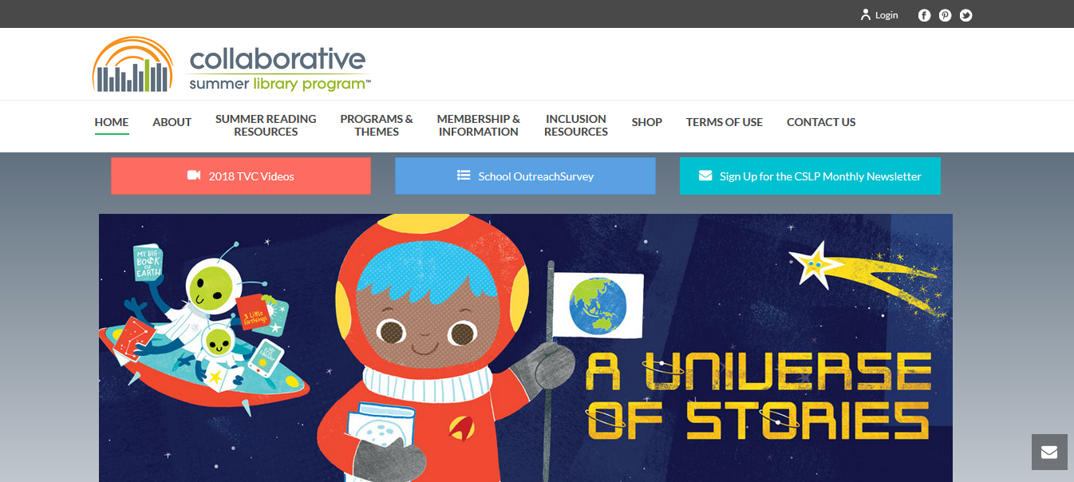

Slide 4
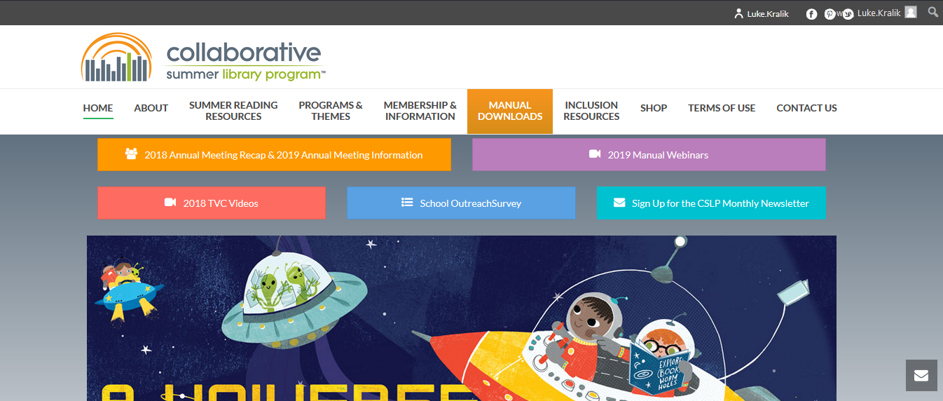

Slide 5
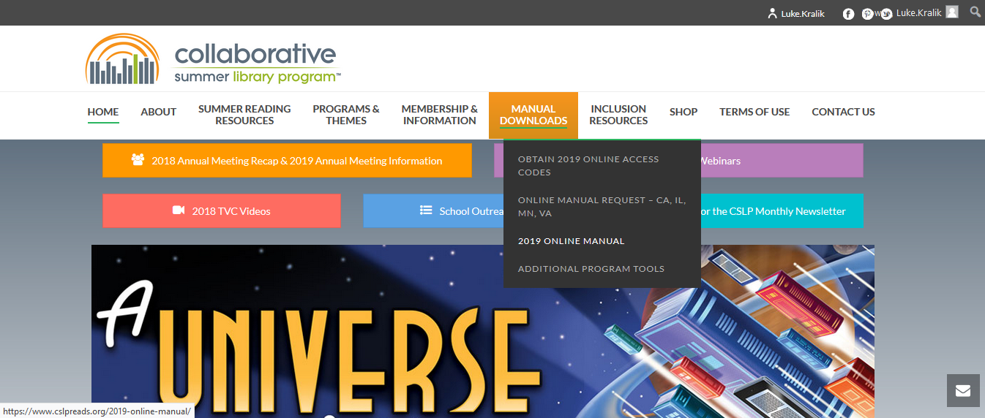

Slide 6
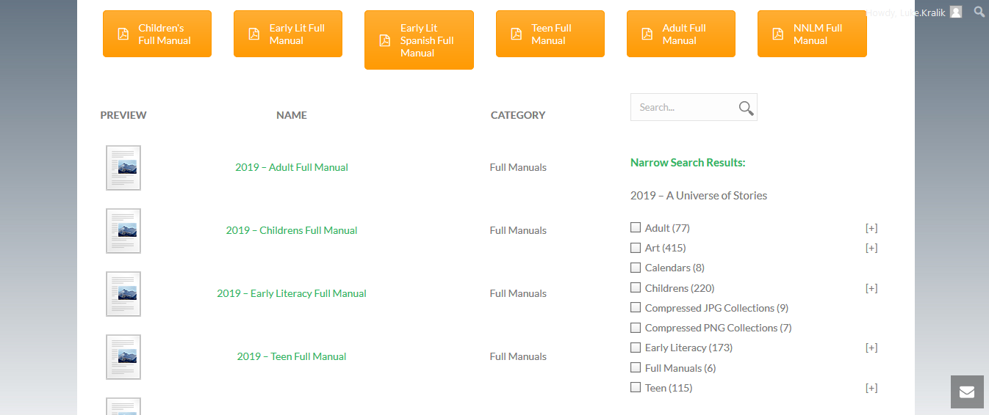

Slide 7
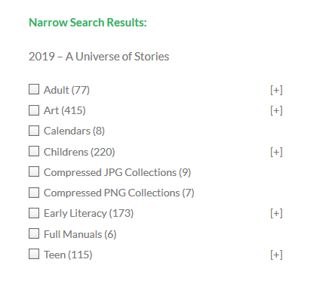

Slide 8
what is the difference between:
png
jpg
larger file size
a little sharper when resized
contains transparency information
smaller file size
perfect for webpages
can degrade with resizing and resaving

Slide 10
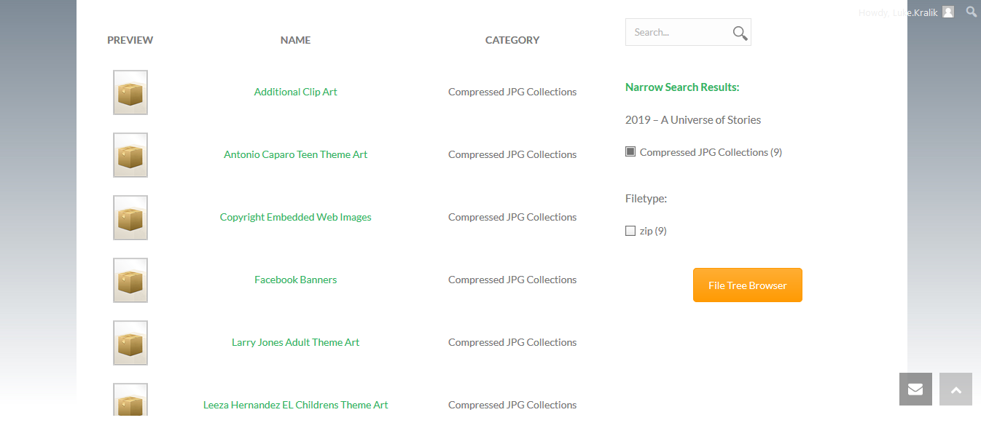

Slide 11
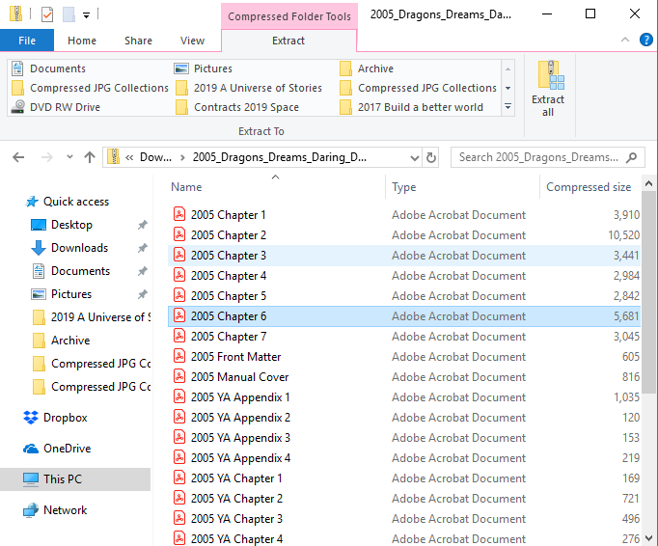

Slide 12
Questions?
luke.kralik@cslpreads.org
karen.day@cslpreads.org
thank you!

